Slide 1
JUKEBOX PROJECT
Name: Rishita Saha
Enrolment No: EN1202207530
Under Guidance of- Vishal Unniyal Sir
Varshini by Mam

Slide 2
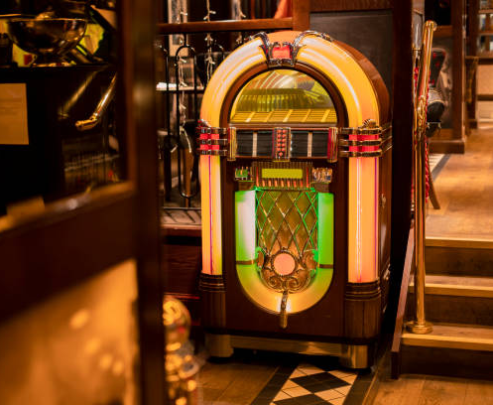
What is Jukebox?
Jukebox is a music player.
Jukebox helps listeners to choose among songs to play music.
I have designed Modern jukebox.

Slide 3
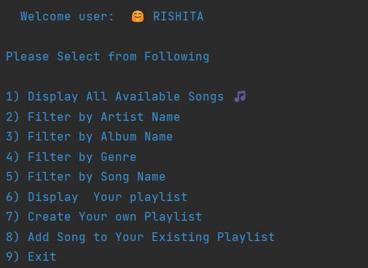

Features of the Jukebox Project:-
Log in or Signup for portal
Viewing all songs Present in jukebox
Filter Songs by Song Name
Filter Songs by Album Name
Play or pause the song
Show Existing Playlist
Creating new Playlist
Add song to the play list.

Slide 4
CONDITIONAL [WHILE LOOP, SWITCH CASE , IF-ELSE, LOOPS] OOPS COLLECTIONS [ARRAY LIST] CRUD OPERTIONS MYSQL JDBC EXCEPTION HANDLING
Features used to impelement project

Slide 5
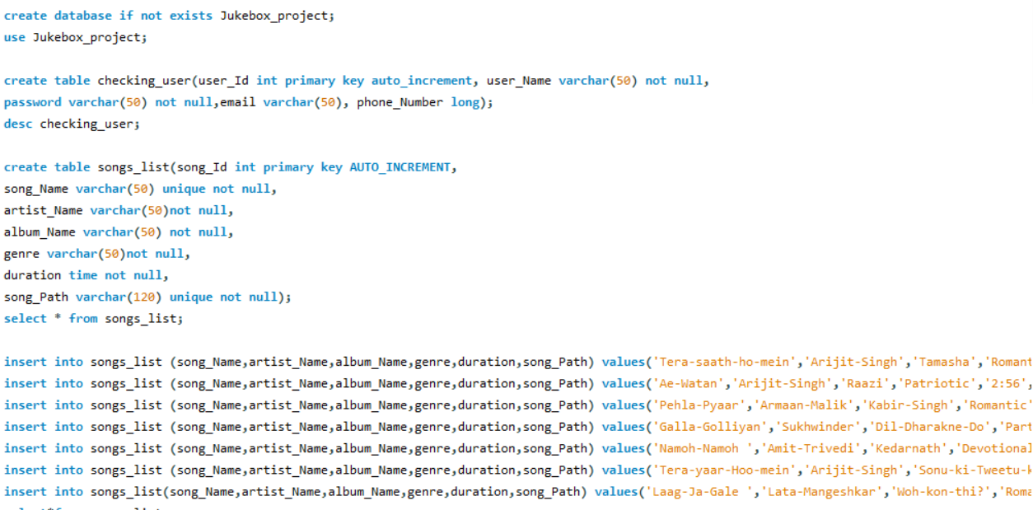
Database Creation
At first we have to create the database structure to begin the project.
The database structure has been showen.

Slide 6
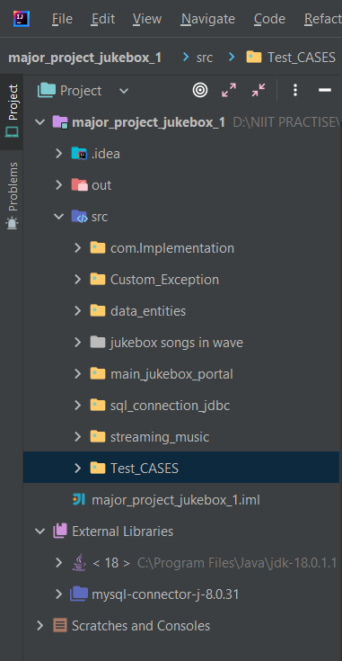
Classes And Attributes
PACKAGES
CLASSES
Playlist Impl, Song List Impl
Incorrect_Password,IncorrectEmail,song not found
Inappropriate_Search,Incorrect_Email,Incorrect_Email,Incorrect_Email
Plylist_display_info, playlist_info,songs_list,user_details
playlist_display_info,playlist_info_songs_list_user_details
All Songs
Checking_user, main_portal, menu
Sql_Connect
Play_song,playlist_id_music,song_url
Jukebox test case

Slide 7
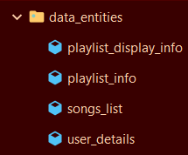
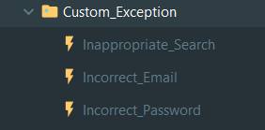
Creating classes to store datas
To store basic data we have created a package called data entities and stored varies data's in respective classes.
Creating Custom Exceptions
Custom exception our own personalized exceptions that are derived classes of the Exception class.
Here for my program I have made 3 custom exceptions
As per my requirement.

Slide 8
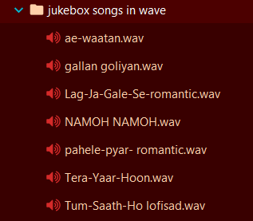
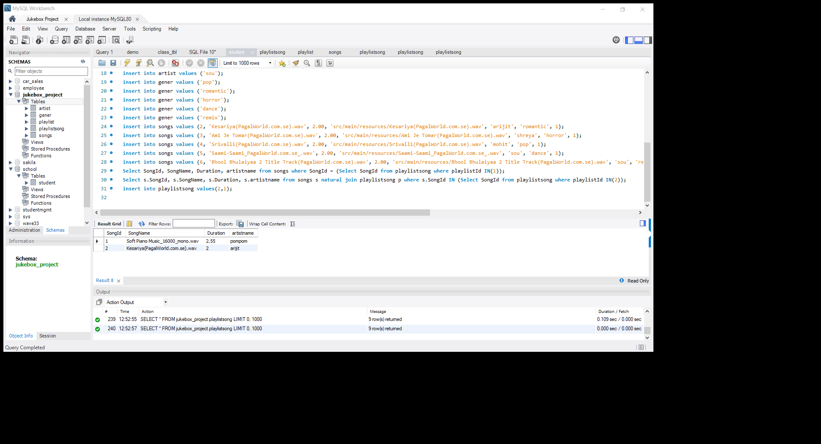
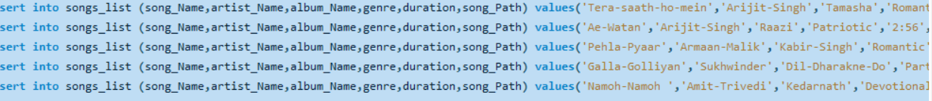
Storing the Songs:-
We’ve store the songs in our resource folder, which content root path has been used to store it in database also.

Slide 9
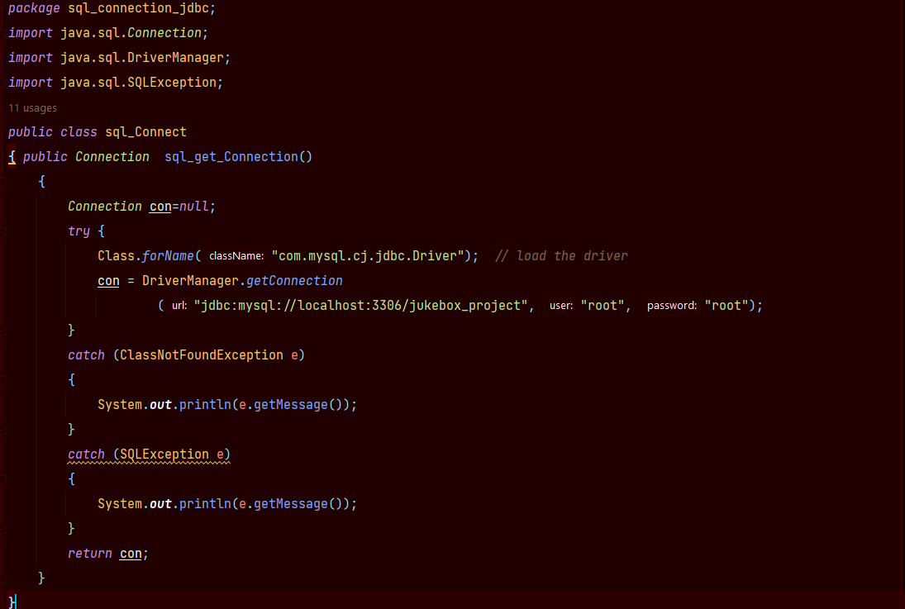
Creating Connection:-
The most important part of our project
is to connect java programming
With database .To do that I have
made separate class SQL connect.
Following code is to connect so
that we can retrieve data.

Slide 10
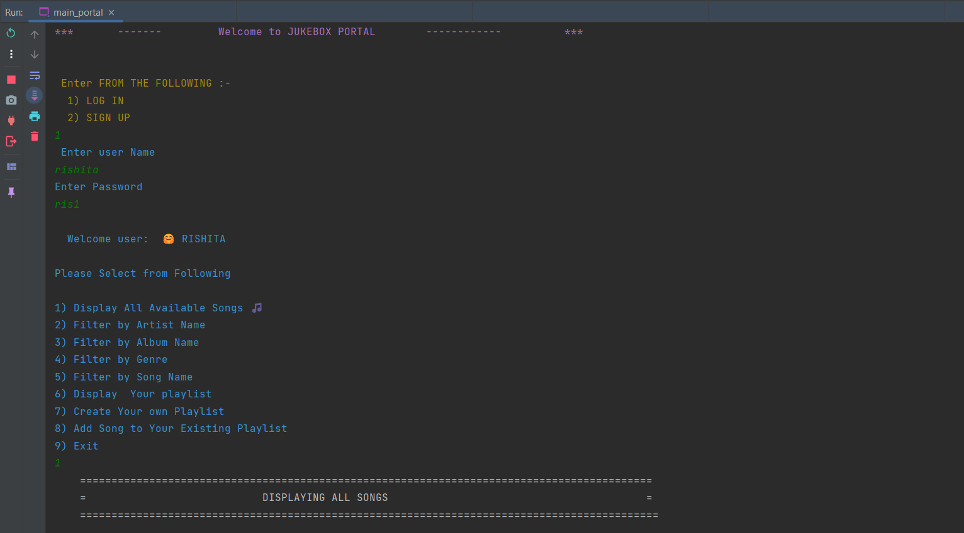
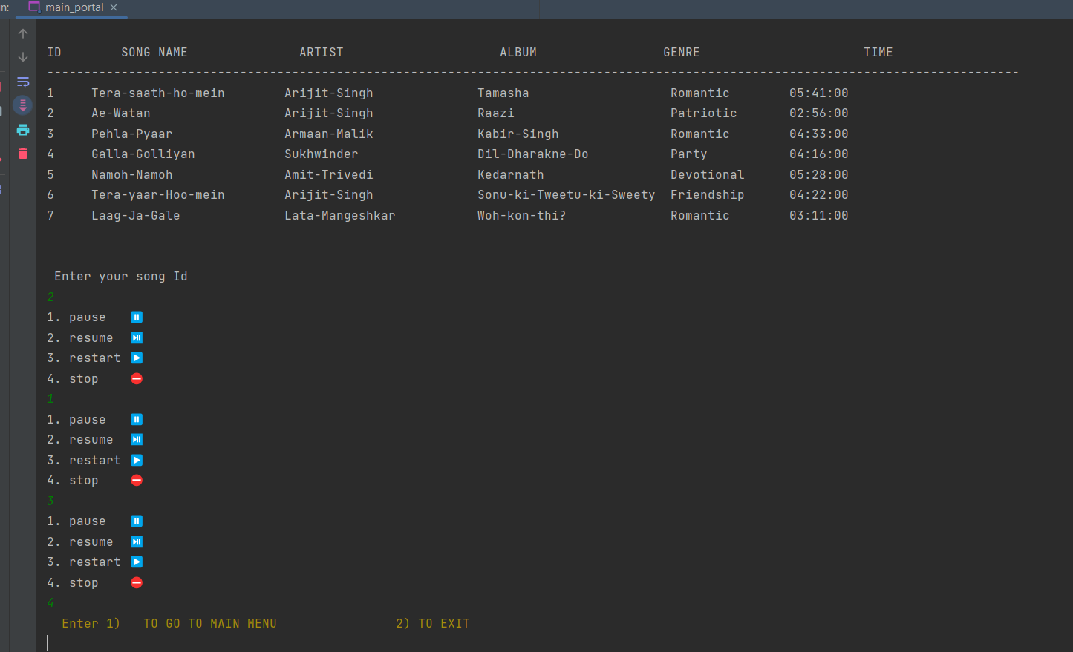
Output:-
Main Portal
Displaying Song

Slide 11
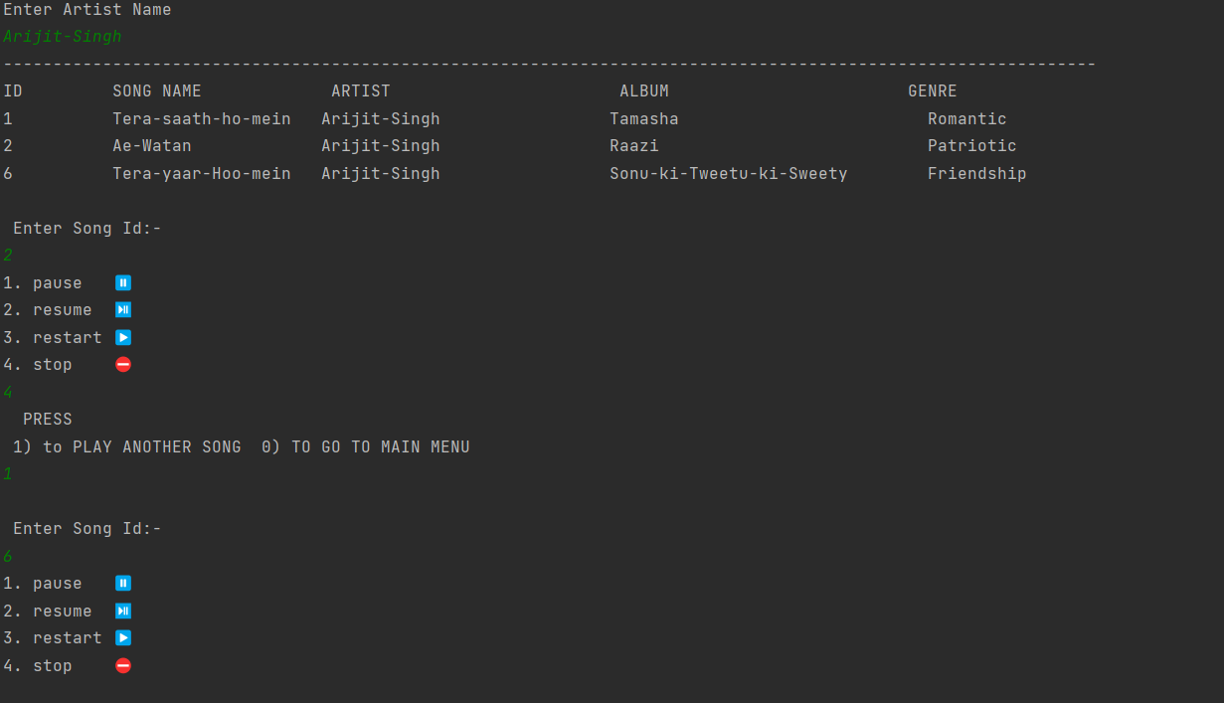
Output:-
Filter by Artist Name
Displaying Song

Slide 12
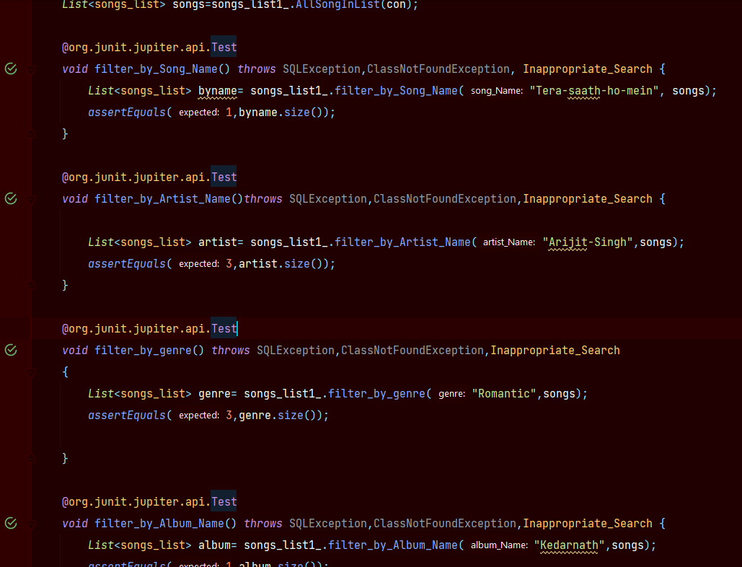
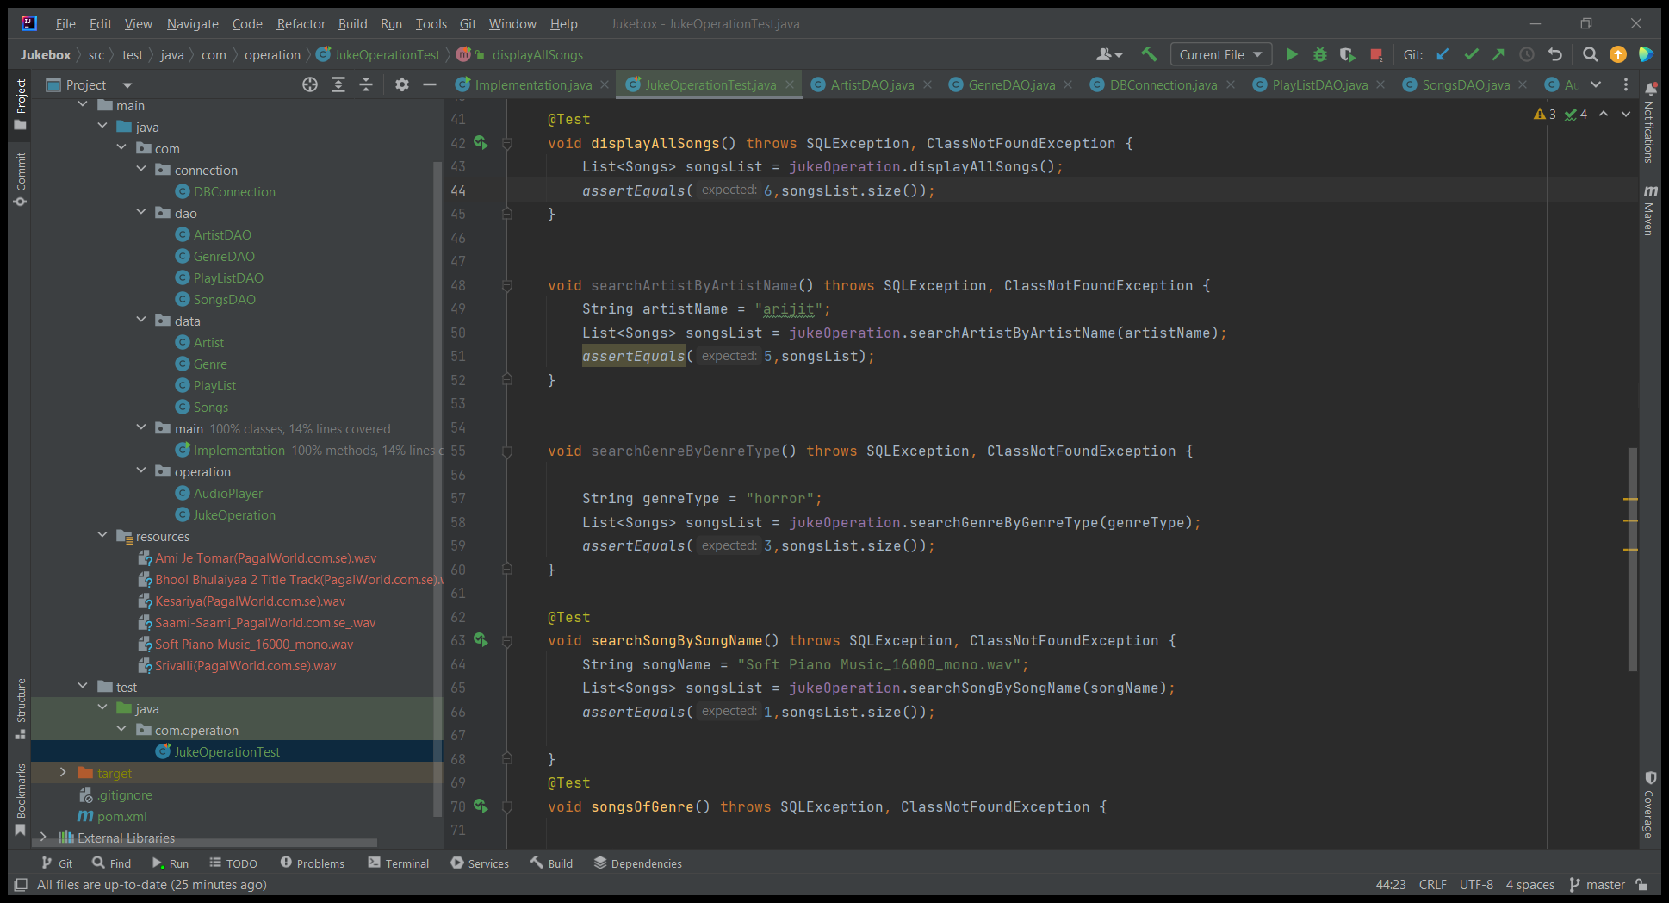
Test Case:-
Creating test cases are
important for the project so
that we can identify if the
project running properly or not
Here are the few test cases
we’ve created for the project.

Slide 13
THANK YOU

